Slide 1
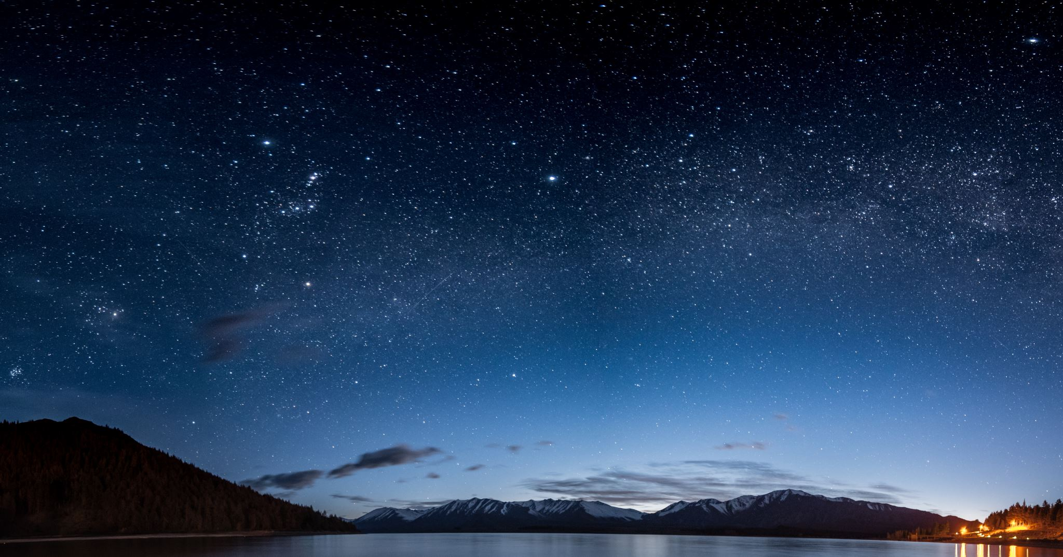
UFO and Meteors Capstone
By: Wiley Martin

Slide 2
Agenda
Data Question
Known Issues / Challenges
Findings
Minimum Viable Product

Slide 3
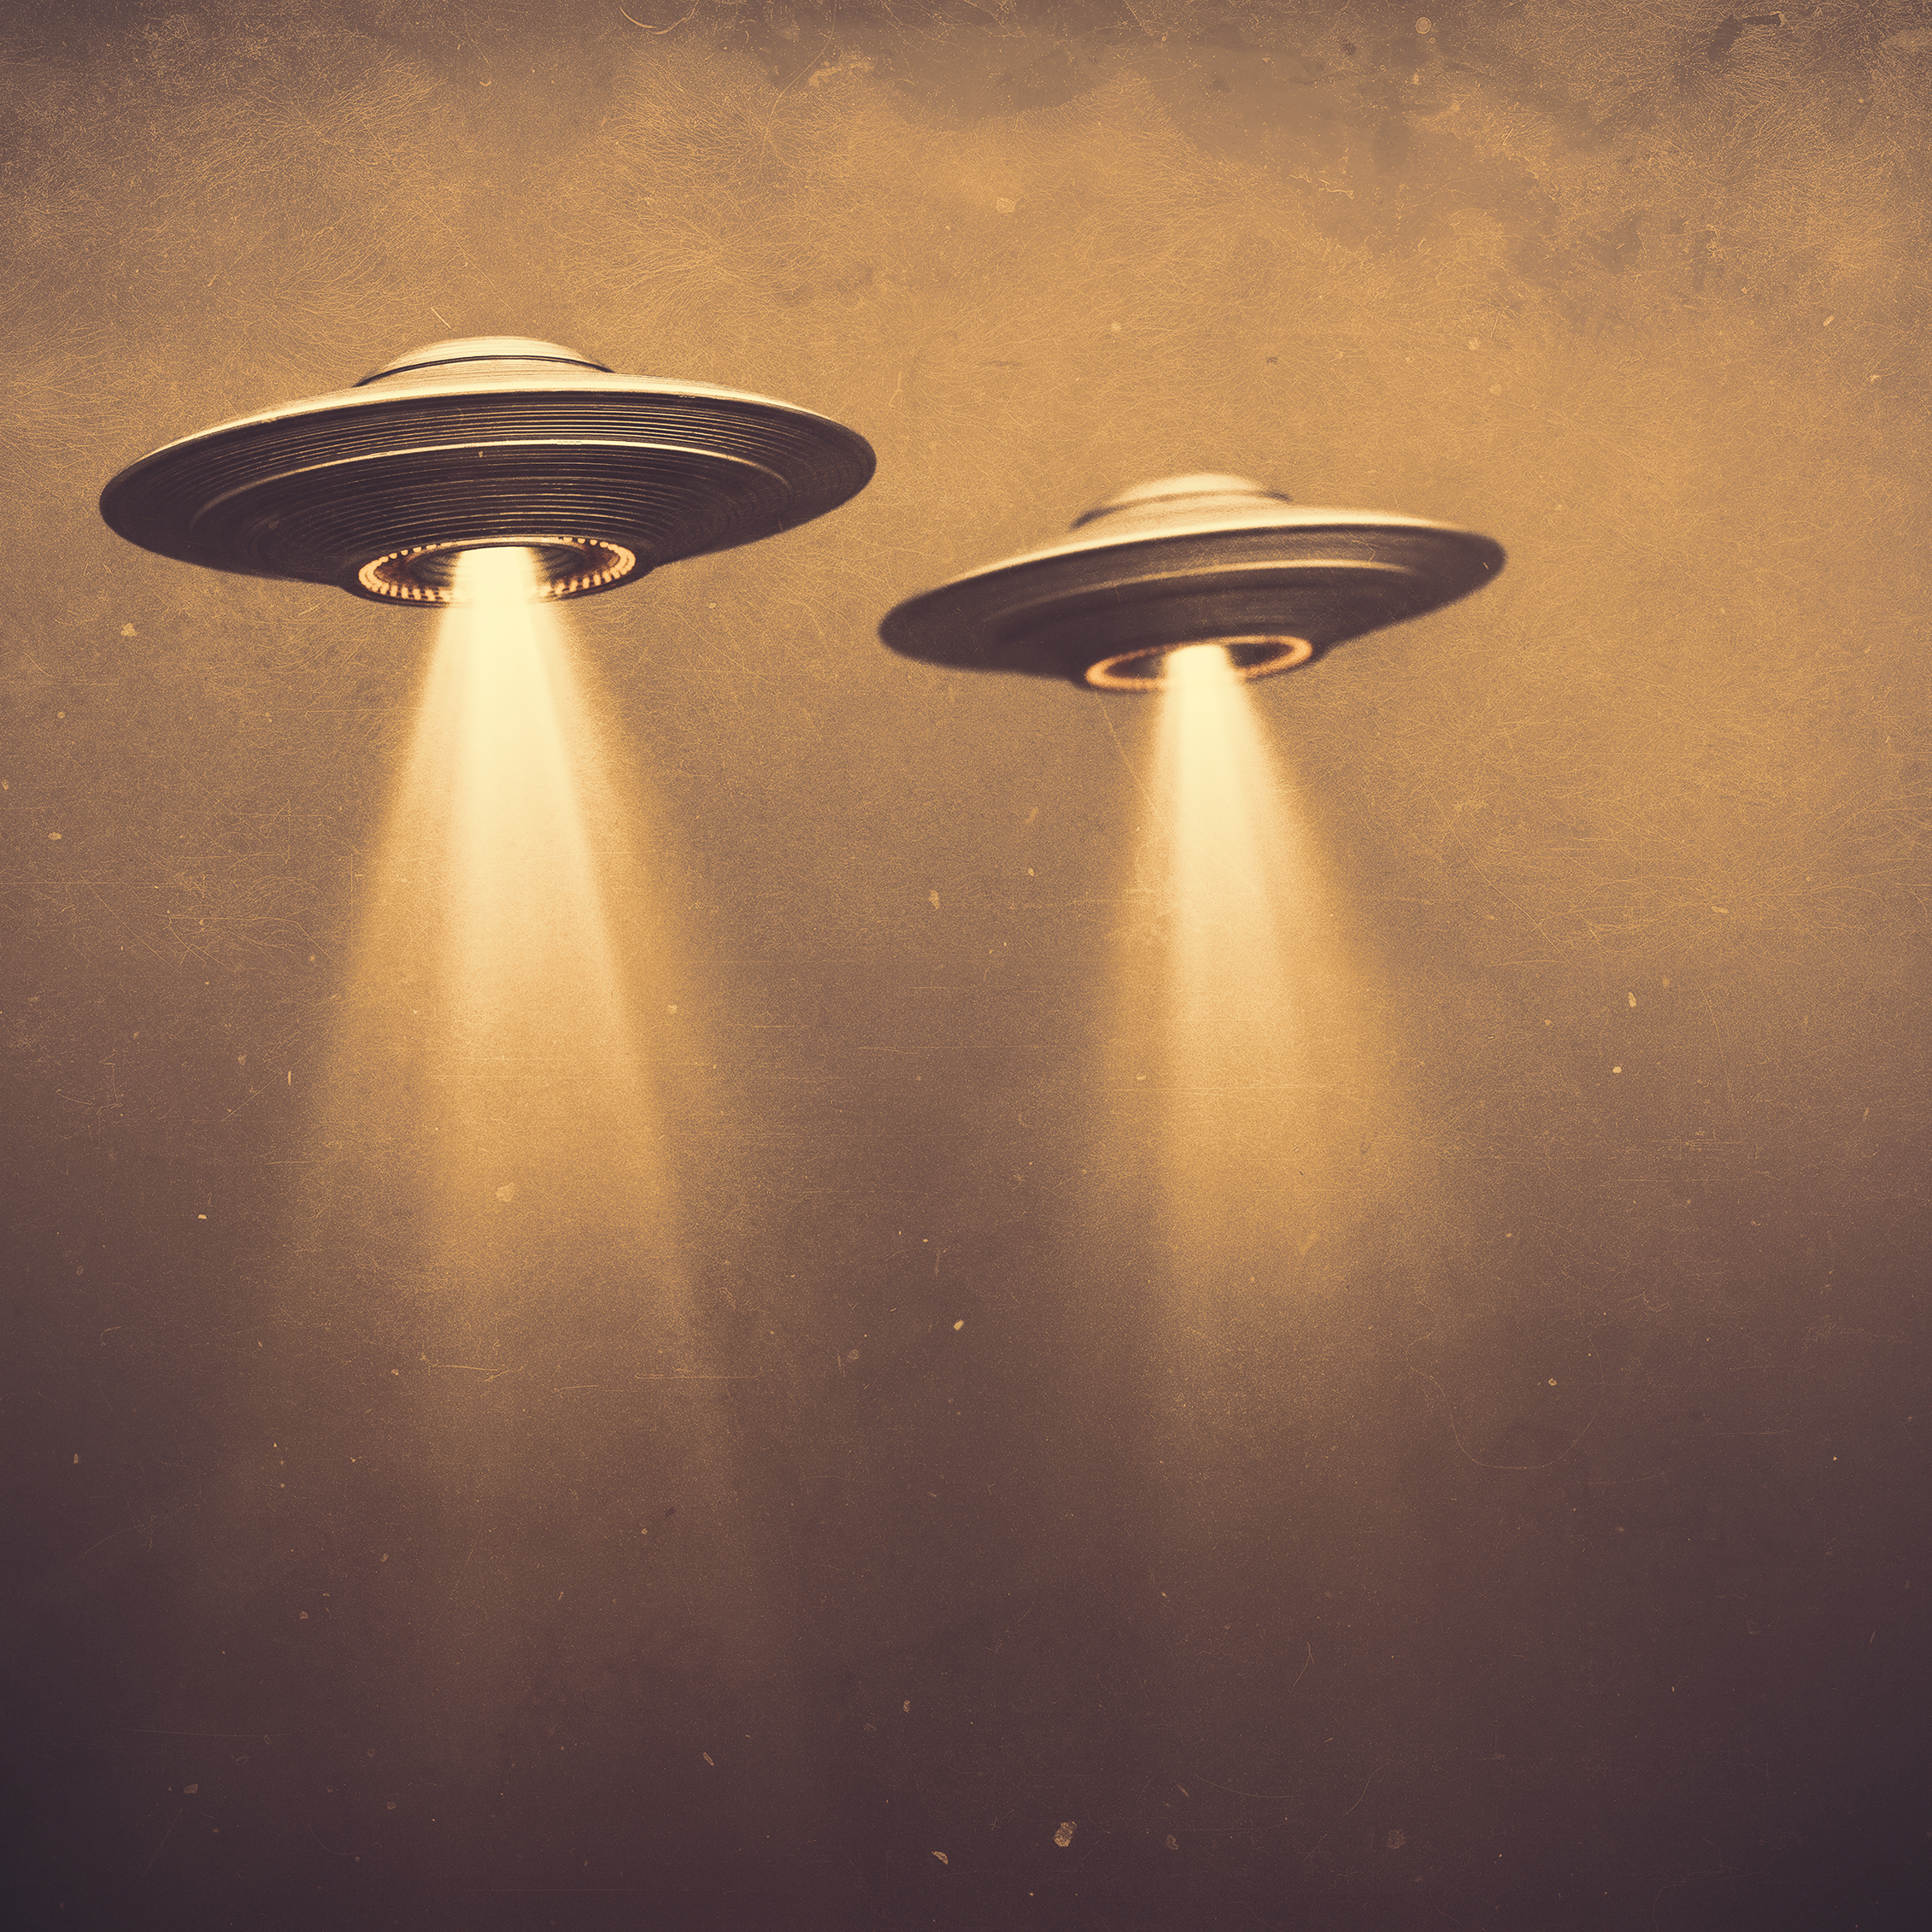
Data Question
Is there a correlation between the count of meteorite fallings and the count of UFO sightings in certain areas of the country?

Slide 4

Known Issues
Issues of credibility behind sightings of the UFOs
Inaccuracy of UFO location sightings
Missing Data
Different formats of datetime among the datasets

Slide 5
UFOs Over the Years

Slide 6
Different Types of UFOs

Slide 7
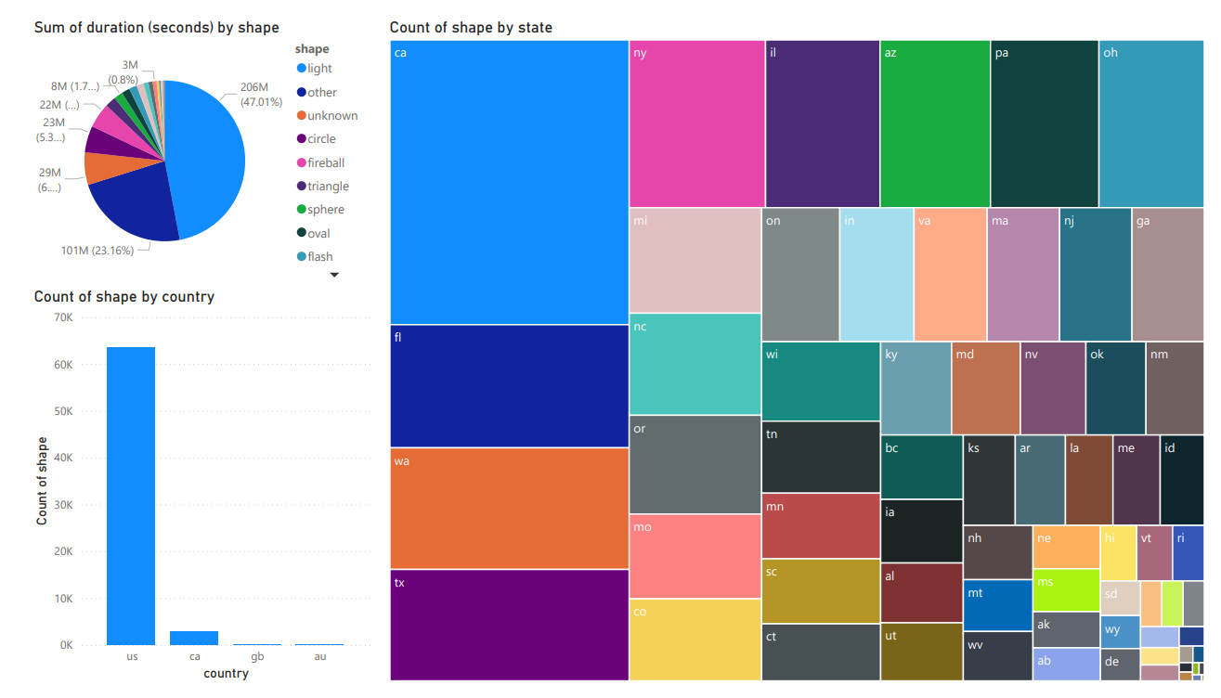
Meteor Information

Slide 8
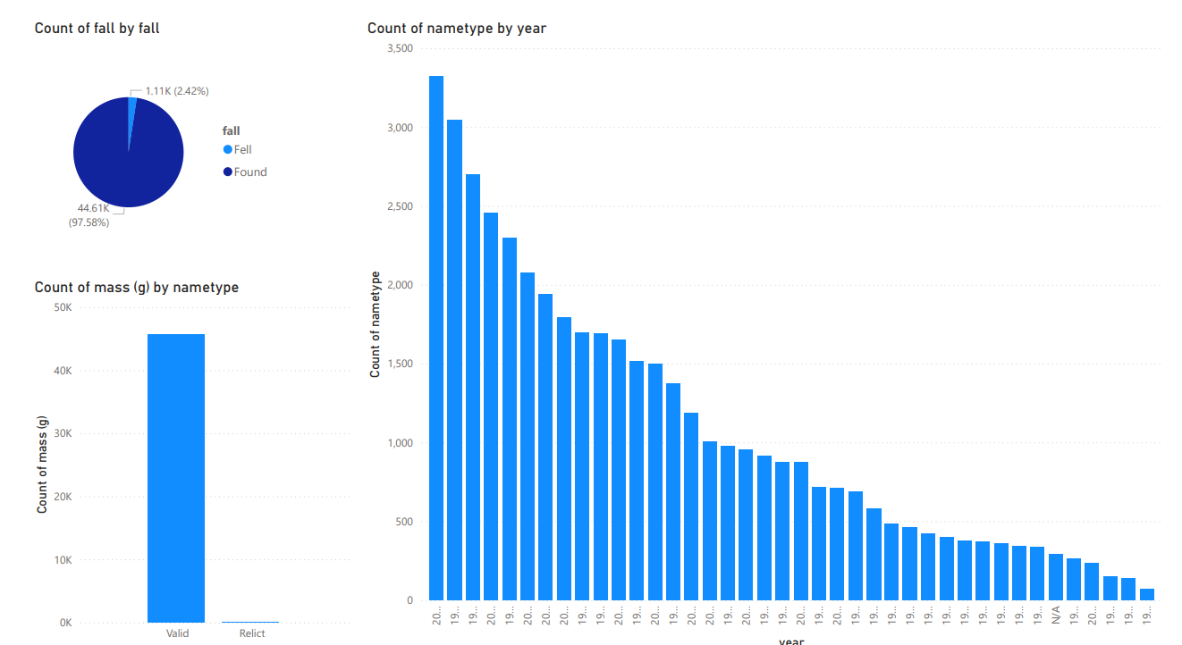
Meteor Information

Slide 9
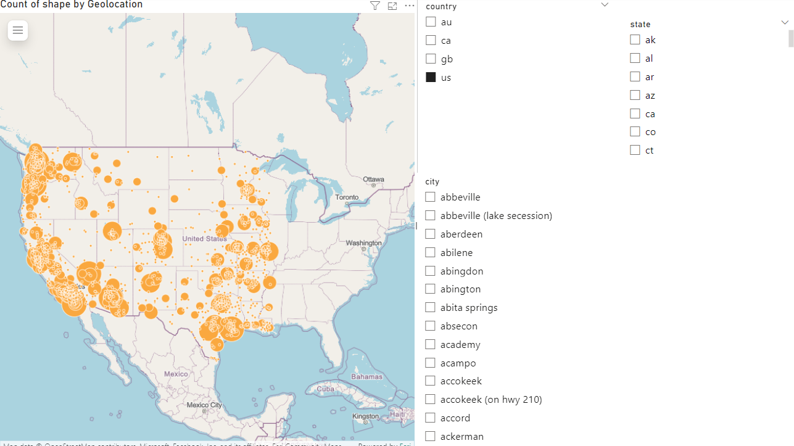
UFO Sightings Across the U.S.

Slide 10
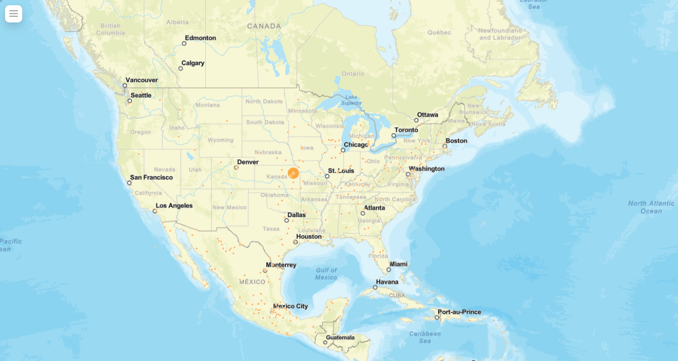
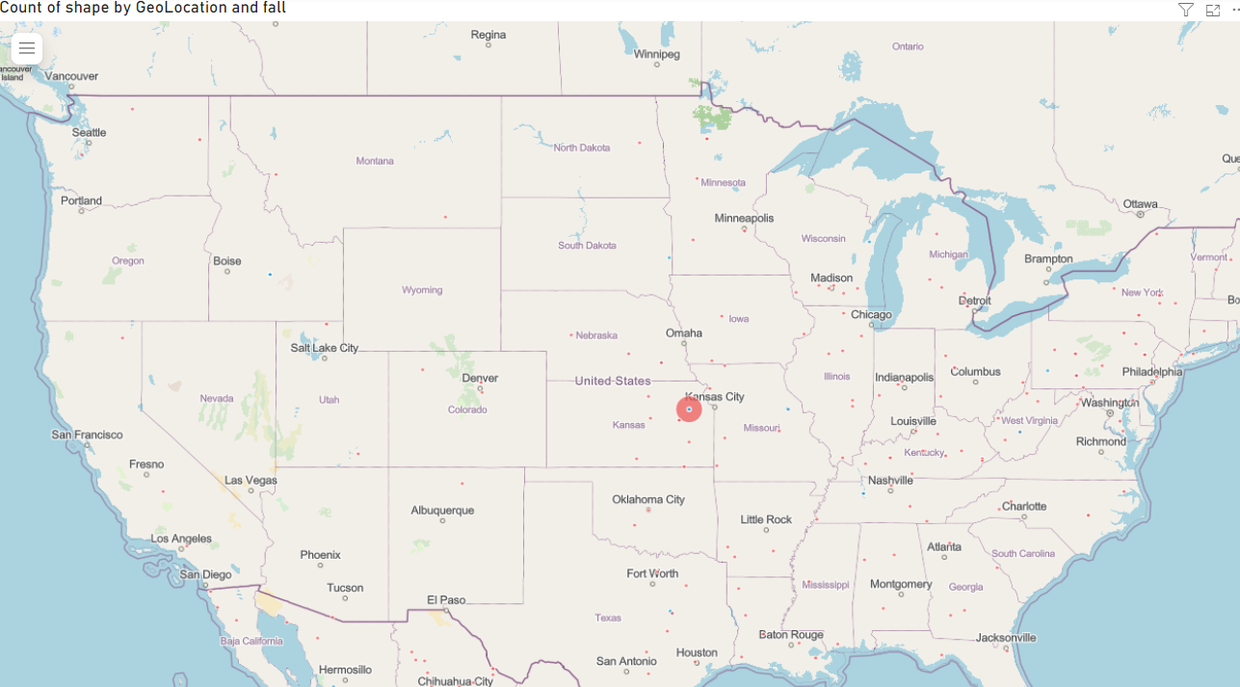
UFOs in Relation to Meteor locations

Slide 11
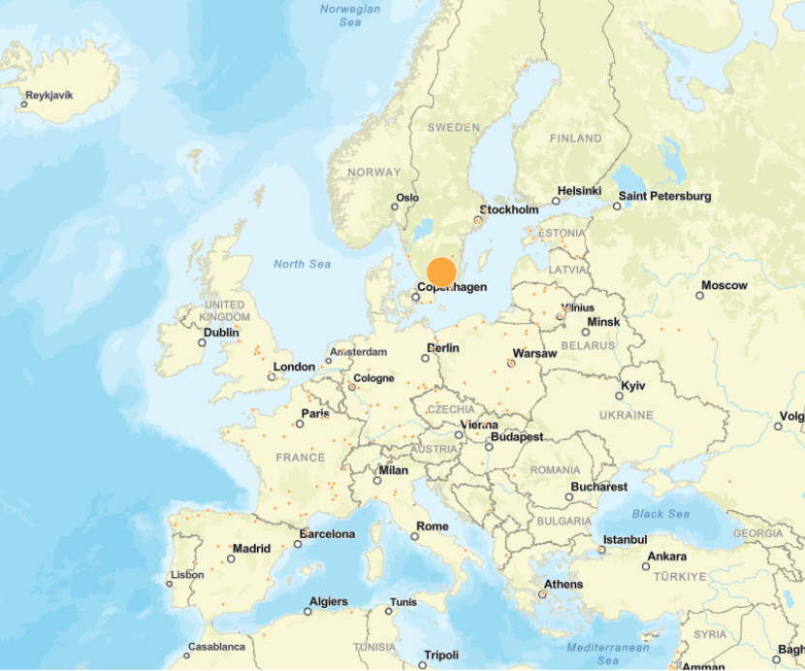
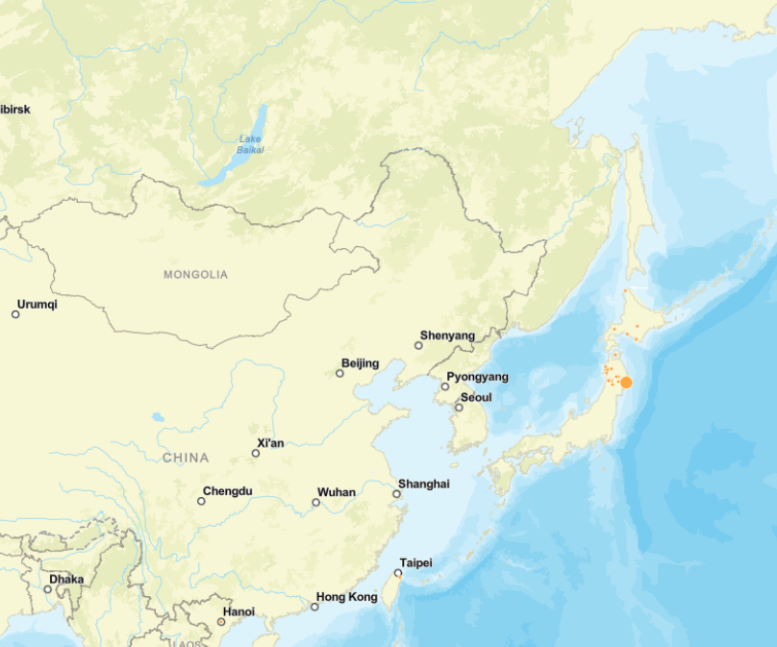
UFOs in Relation to Meteor locations

Slide 12
Positive Correlations
Only locations showing a positive correlation between meteor crashes and a high count of UFO sightings are below
- Topeka, Kansas
- Stockholm, Sweden
- Sendai, Japan

Slide 13
Data Sources
Meteorite Landings - Catalog (data.gov)
UFO Sightings (kaggle.com)

